Slide 1
Sustainable Rural Futures: A health perspective on Bishop's Castle Community and Youth.
Andrew Miller Brodie Kain Hannah MacDonald
Harriet Koch Joanne Tiu Laura O’Brien
Olivia Lawson Sophie King Tahlia Matthews

Slide 2
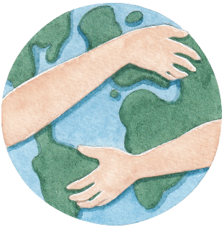
Introduction to Bishop's Castle
Bishop's castle is a small rural town located in the heart of the countryside southwest of Shropshire, West Midlands, England, United Kingdom.
Bishops Castle is located 1.5 miles from the Welsh boarder, 20 miles southwest of Shrewsbury and 20 miles northwest of Ludlow.
The estimated population is expected to be 1900 residents in 2022, with primary ethnicity being white.
Bishops Castle is a tight-knit community that takes pride in their community's values and beliefs and uses the gifts and talents of the people living in the community.

Slide 3
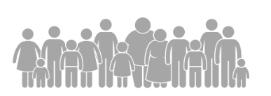
Community Assessment
Education
Only one community college in Bishop's Castle. Finishes when adolescence reaches the age of 16, then must travel out of town for further education.
Health & social services
Bishop's Castle community is left with minimal health services due to the closure of the health center in 2021, due to limited staffing. The nearest hospital is 20 miles away. For the health center to reopen, there must be at least 85% of the clinical team as permanent staff.
There is one local doctor for around 5000 patients.
Communication
Interactive Moodle hub is still under development and not yet launched to community members.
Employment
Limited job opportunities for youth finishing school. There is a high proportion of self-employed individuals within the community.
Poverty
Many families in Bishop's Castle are having to decide to heat their homes or to eat due to the price of living being significantly high. a standard shop for groceries is £34, Clun is 11 minutes out of town and costs £40 Travelling to Ludlow is 30 minutes out of town and cost is £18.
Housing
The average rental price averages between £100 to £300 per week. Average price to own a home is £280,000. With the price of living increasing, families are looking to move to the outskirts of the English border.
Transport
Main forms of transport are personal cars, cycling, walking and by bus. The bus service is limited within Bishop's Castle.

Slide 5
Health Need: Youth Mental Well-being
Research question:
“To promote the mental well-being of the youth in Bishop’s Castle, are there opportunities within the community to sustain and improve mental well-being?”
Five main points:
Mental wellbeing
Mental-ill health
Youth
Rural opportunities
Rural mental health
Key findings:
Increased prevalence of mental ill-health. among youth, particularly in rural areas of the UK.
Living rurally causes many barriers to access to mental health services.
Lack of opportunities within rural areas resulting in a decreased level of mental health and mental ill-health.
A focus on the need for increased mental health awareness and opportunities for youth within Bishop’s Castle.

Slide 6
Health Need: Community Sustainability
Research Question: “Will the Community Thrive Model for the population of Bishop’s Castle improve rural sustainability?”.
Main Points from Literatures | Key Findings
Covid 19, Brexit, Ukraine war | Resulted to an economic fallout = Poverty Gross Domestic Product and Health and Social Work sector decline Decreased job posting Supply chain disruption
Rural Community Empowerment | Empowerment and facilitation of key roles is important
Social Capital | Enables members of the community to address issues as a collective group
Sustainability | Availability of vocational & age-appropriate programs Programs on food sustainability Transportation Healthcare availability and delivery
Community Thrive Model | Potential to link the gap between currently segregated health and social . services in the UK

Slide 7
Health Promotion Message
The Ottawa Charter:
Intentions of these two health frameworks is to guide our resources towards giving the residents of Bishop's Castle as much power in their own health decisions as well as in how their community that they live in will influence their health.
Enable.
Mediate.
Advocate.
Empower.
Te Whare Tapa Whā :
Spiritual, Physical, Mental and Social Health

Slide 8
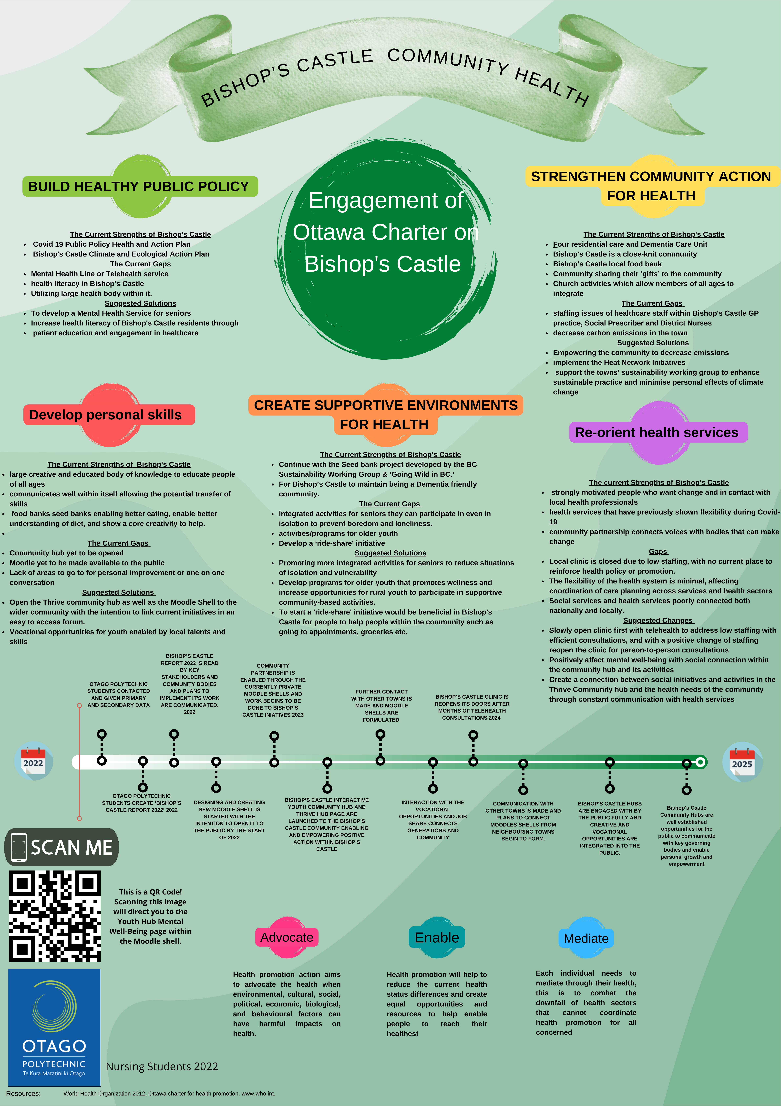
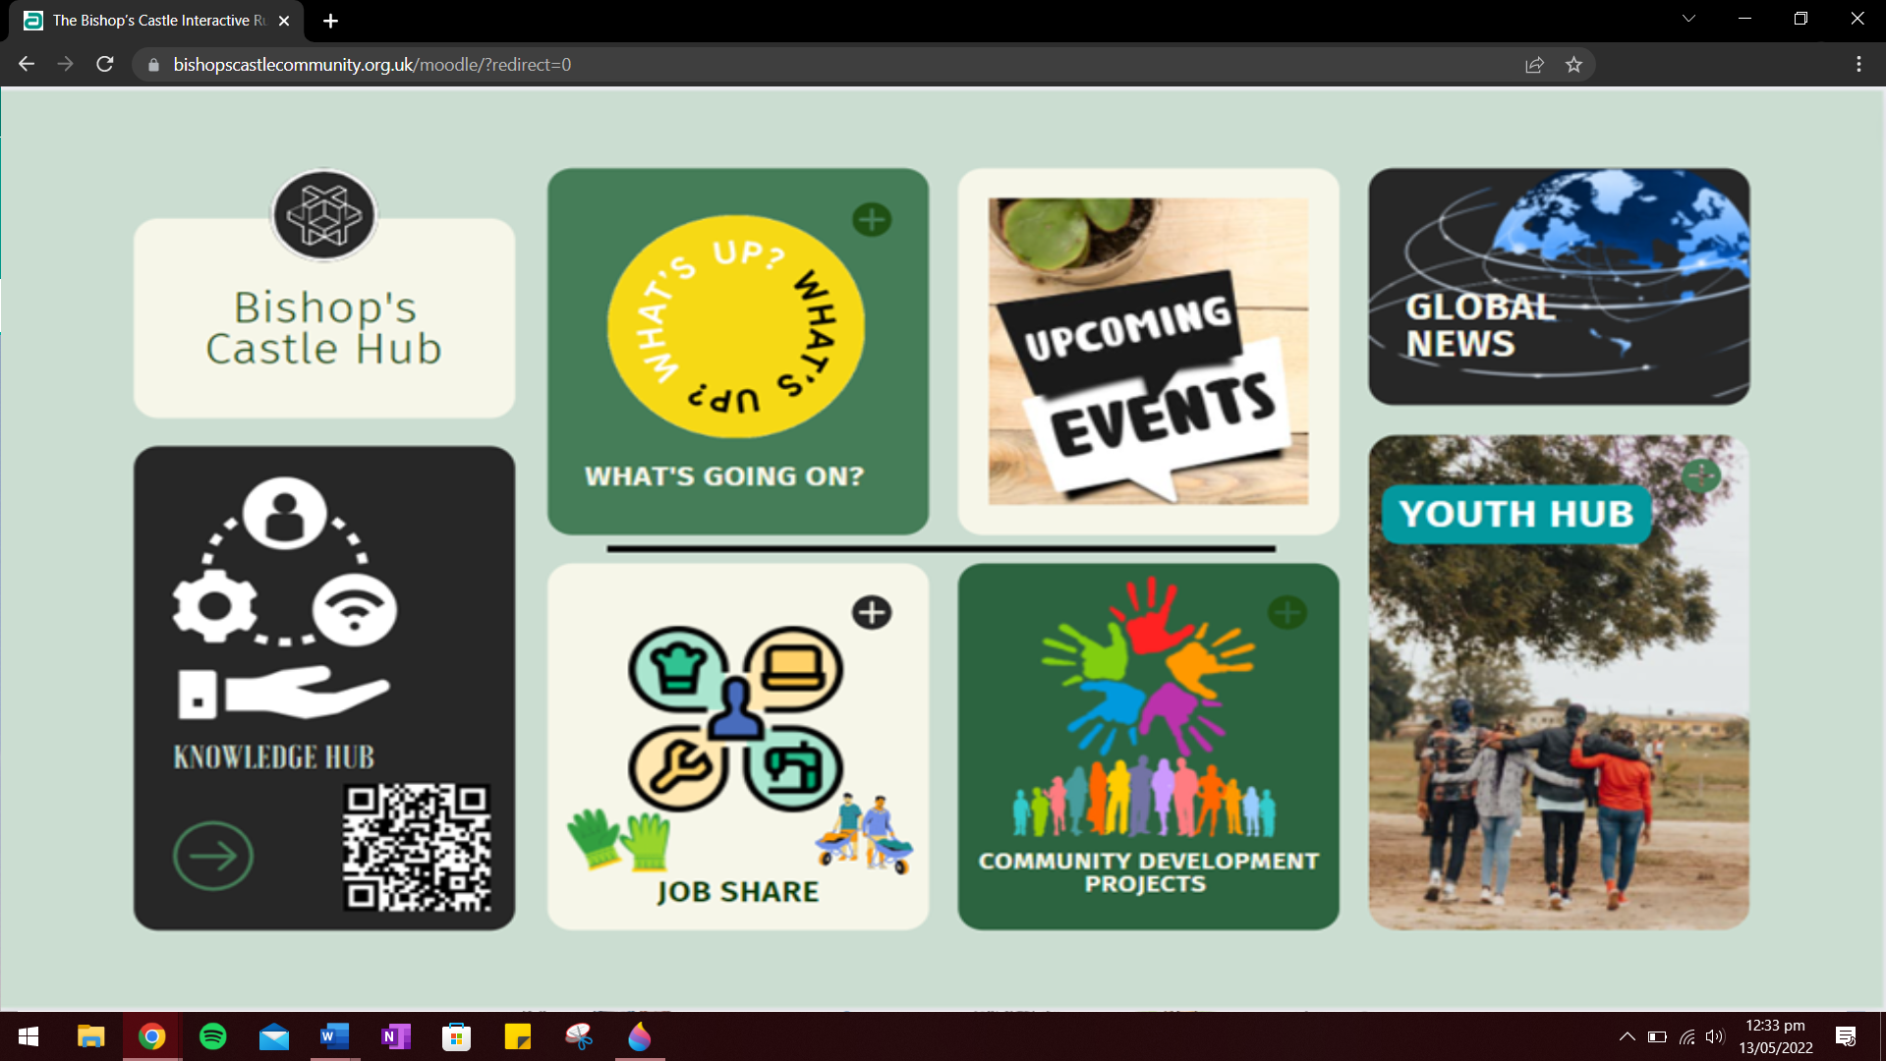
Community Health Promotion
Notes:
Now i'm going to talk about our community Health promotion and the resources we came up with and talk through them.
Firstly, is our website design that not only attracts the eye but has heaps of free resources through the button knowledge
hub just to the right on the button there is a QR code,
This QR will take those who scan directly to the youth hub mental well-being moodle shell. ,
but offers the community a place to put up their thoughts and ideas in the 'What's up' button.
The Job share is pretty self explanatory but I'll elaborate as it ties into our youth resource that
allows community members to add jobs they need done and youth to sign up and
be part of an entrepreneurial skill growth project.
Thirdly our upcoming events that has links and resources to events in the greater shropshire area.
Community Development projects is an initiave already taken on by the stakeholders in Bishop's castle
that has strong links to the community members and local members of council
and greater bodies for action.
Finally, the Youth hub.
This button is a direct link to the youth moodle shell.
Poster concept resource two.

Slide 9
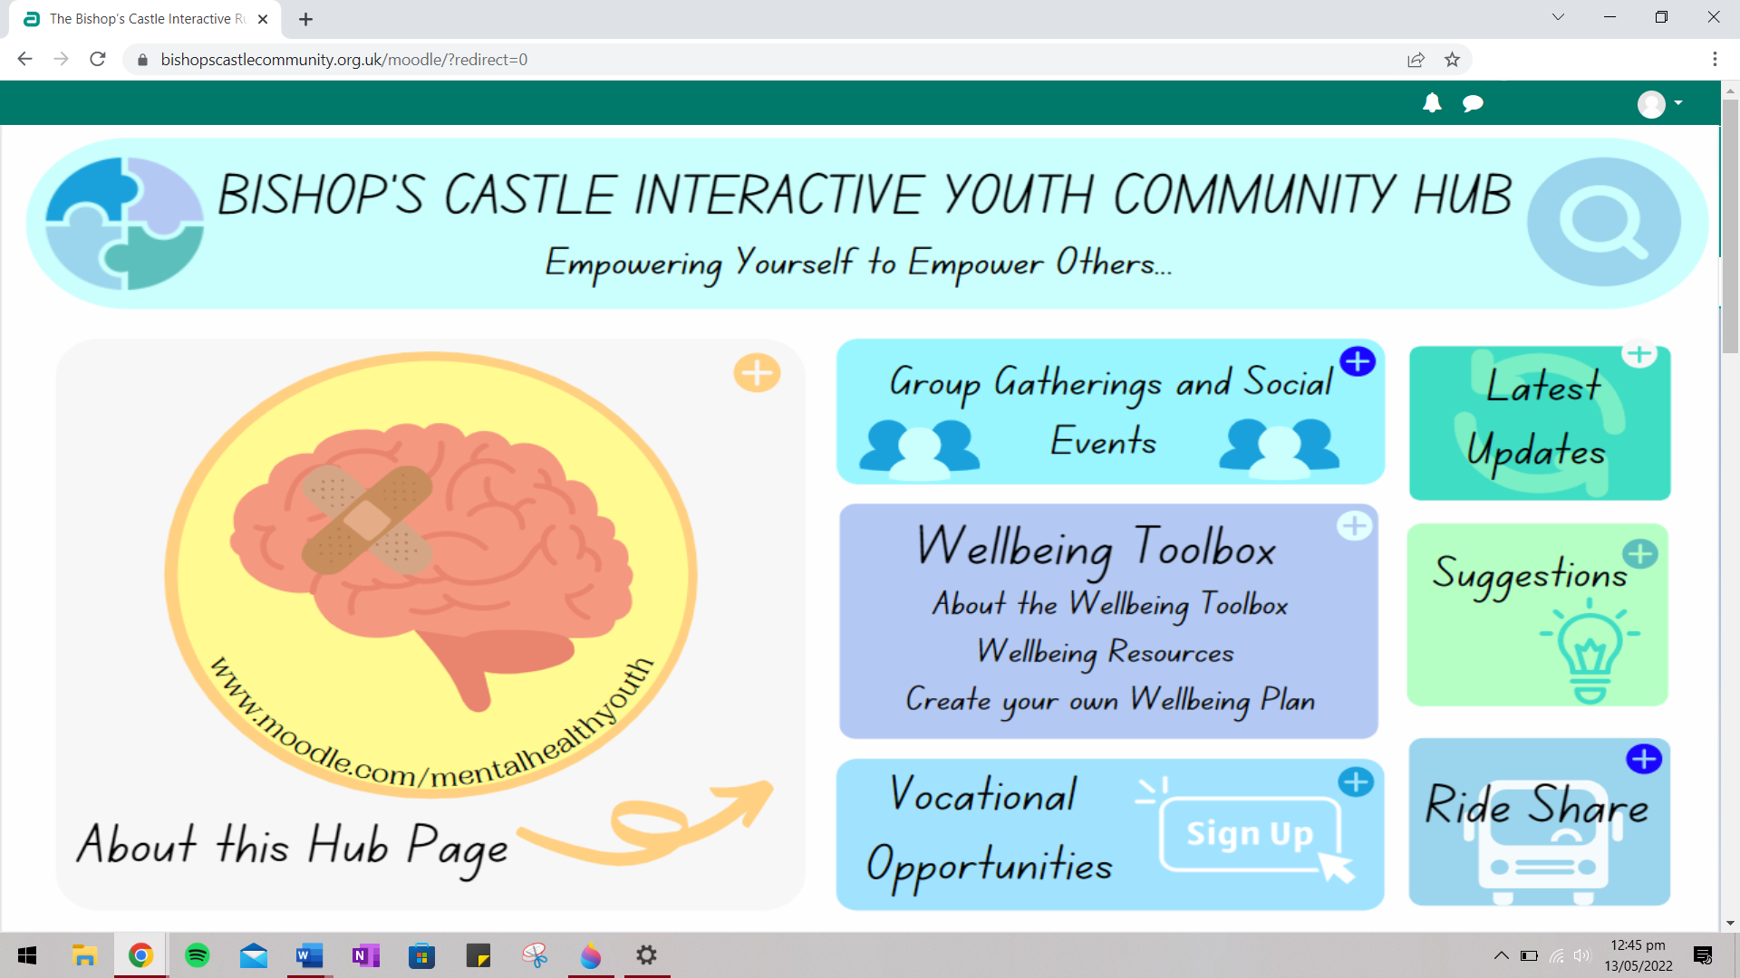
Youth Health Promotion
A rejuvenated shell providing bright colours and an easy-to-use tab selection containing relevant information.
Resource One
The Moodle shell could strengthen the community through cooperation and online interaction.
Includes 7 tabs that we as a group think can be aimed to increase participation and empowerment in youth.

Slide 10
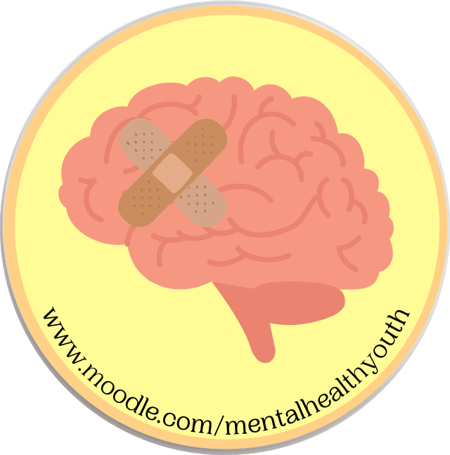
Youth Health Promotion
Resource Two

Slide 11
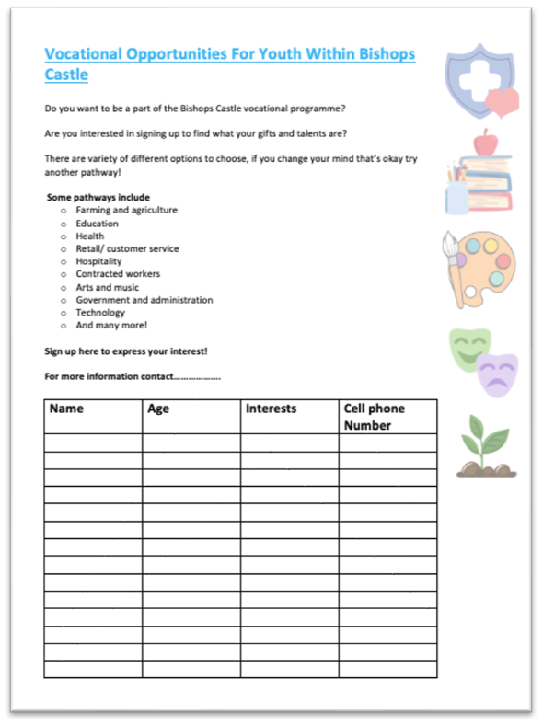
Youth Health Promotion
Resource Three
Vocational opportunities involve contribution from the wider community allowing youth to gain experience that can in future help Bishop's Castle.
Vocational opportunities have been known to increase youth self-development and encourage dependence.
Allows for self-discovery and identification of one's 'gift' that can be utilised within the community.

Slide 12
Summarizing Our Efforts in Bishop's Castle
Previous years' work, how it has been built on.
The positive impact of the Bishop's Castle 2022 Report.
What has been given to Bishop's Castle.
Final words.

Slide 13
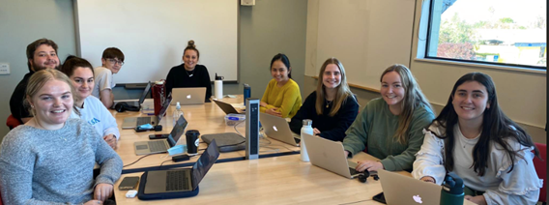
Acknowledgements
Thanks to; Keith Whiddon, Hope Robson, The Bishop's Castle wider Community
And of course, Jean Ross.

