Slide 1
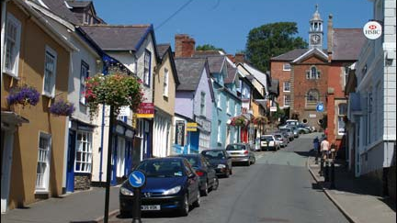
Welcome Bishop’s Castle Community!

Slide 2
Today’s agenda..
EXPLAINING THE PARTNERS & STEERING GROUP
WHERE? WILL IT BE….
WHAT? WILL IT LOOK LIKE…
WHATS THE DEMAND/EVIDENCE
HOW DOES IT INVOLVE THE COMMUNITY?
HOW DOES IT FIT WITH LOCAL ACTIVITIES?
WHO WILL BENEFIT?
FUTURE PROJECTS WORKING ALONG SIDE ‘THRIVE COMMUNITY HUB

Slide 3
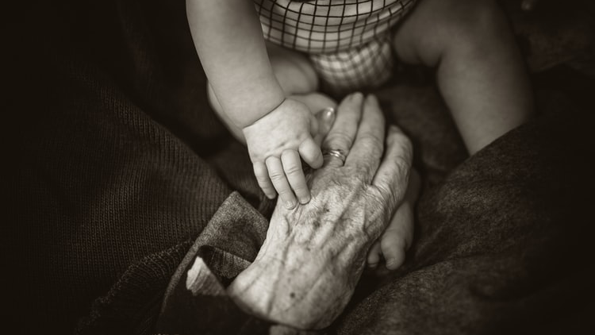
The background story…..

Slide 4
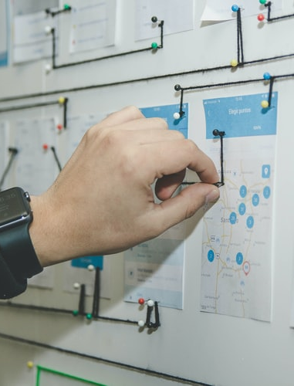
Connection to current local activities- Bishops Castle Community Partnership
Community Town Plan
Adopted by Bishop’s Castle Town Council April 2020
Community and Services Action Plan 2020-2022: “To address the issue of continuing threats to the provision of statutory services, in particular:-
develop a Community Hub to support the needs of vulnerable and other groups. A facility that promotes mental health and well-being, using creative team building and networking opportunities to develop community knowledge and skill-set, helping to form an optimistic thriving community, full of opportunity and prosperity.”

Slide 5
‘Bishops Castle Thrive’
A network that supports and enhances the lives of vulnerable people as well as other groups by promoting health, wellbeing, skills and knowledge. Harnessing the talents and resources of our local community.

Slide 6
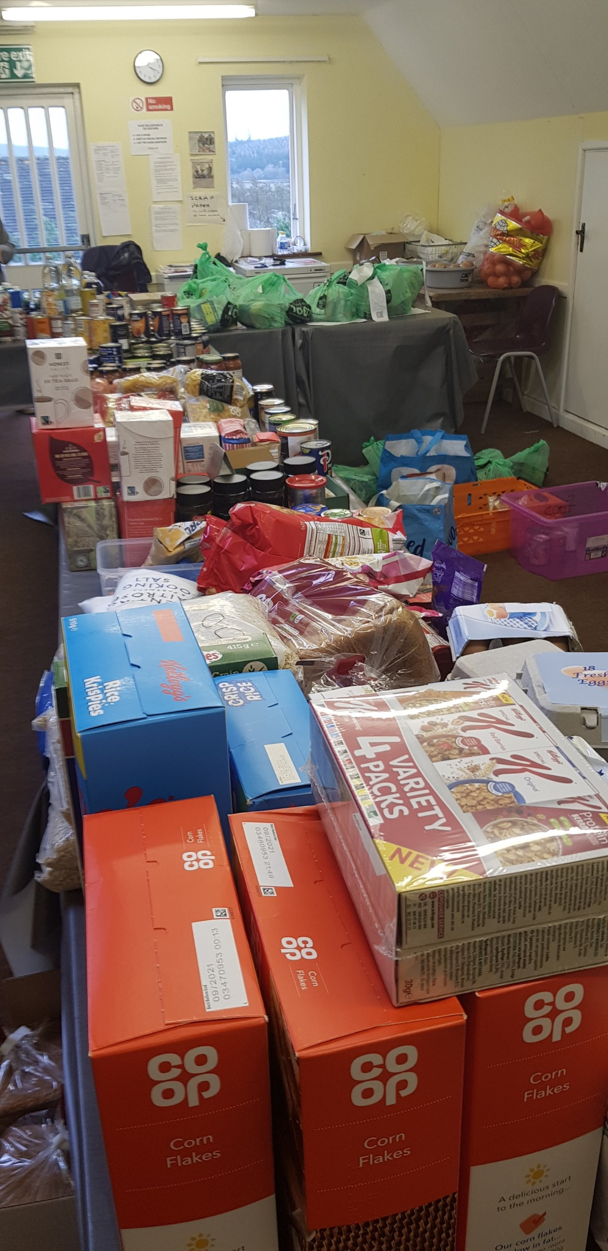
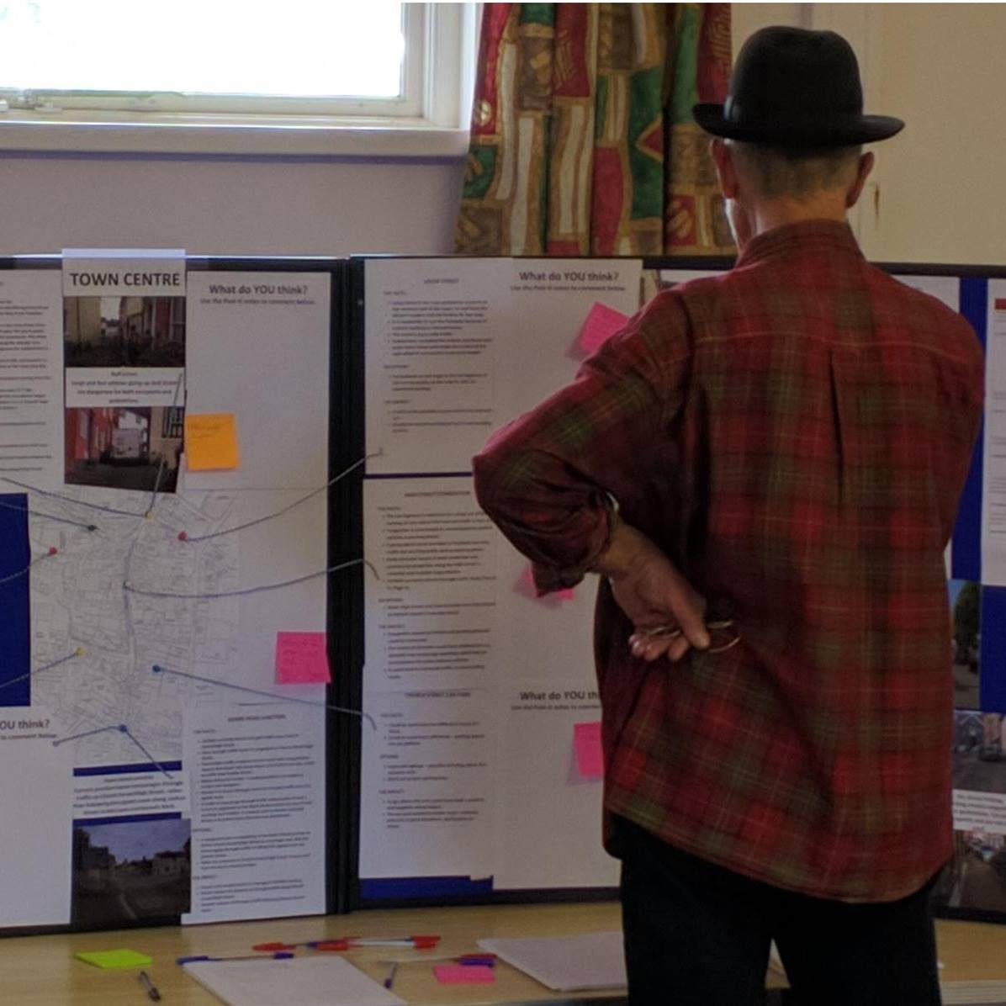
Our Steering Group
‘Bishop’s Castle Thrive’ has a steering group that has representatives from local groups that have community enrichment as their main ethos. Our steering group consists of 6 members who are dedicated to the concept. These representatives are from the following organisations:
Bishop’s Castle Community Partnership
Enterprise South West Shropshire
Bishop’s Castle Town Council
Bishop’s Castle Community Food Bank
Bishop’s Castle & District Community Land Trust

Slide 7
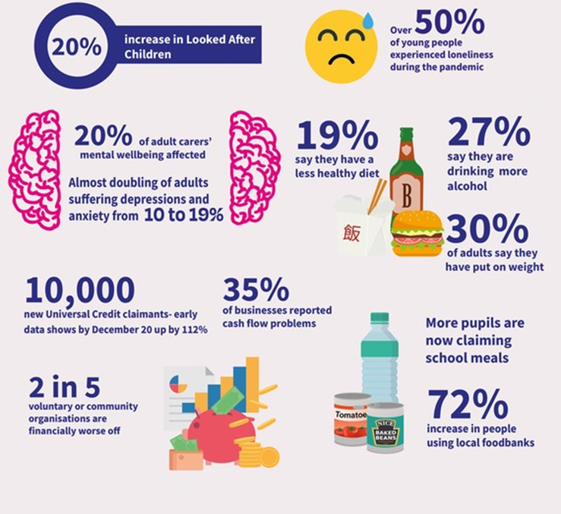
What’s the demand? One year into COVID-19
Recovery of community health and well being is important and needed.
We need to look at the community in a holistic way and understand how we can help community needs and promote inclusion and prosperity in all groups.

Slide 8
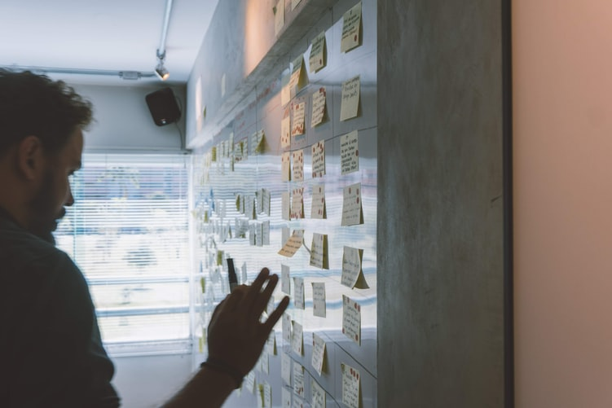
What’s the demand?
The Food Bank was only established April 2020 – now has about 85 clients per week
What’s the Demand / Evidence?
High proportion of older people in Bishop’s Castle - 23.9% aged 65 and over, compared with 16.3% nationally
9 suicides among young people in the 5 years preceding 2020
37% increase in Free School Meals in Shropshire 2019-20
Social isolation - significant number of people aged 50+ living alone in Bishop’s Castle compared to national average
Little provision for regular and organised leisure activities for children and young people
Limited public transport services makes access to advice and advocacy services such as Citizens Advice difficult
Post-16 education travel costs are costly - preventing many young people accessing further education
Limited job opportunities in the Town

Slide 9
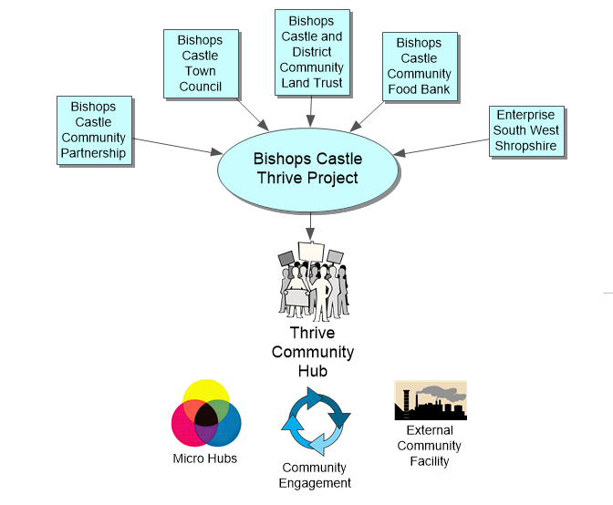
Creating a network with community engagement & inclusion
The Background of Working Together WHAT?
We have pooled our knowledge and Professional skill to create ‘Bishop’s Castle Thrive’
We understand that there are a lot of opportunities in this town and our community could tap into these opportunities if a system was made that’s easy to use for everyone

Slide 10
Thrive Community Hub Walk in → Talk to us → Connect in to your community
‘A facility that holistically supports the needs of vulnerable and other groups; promoting good mental health and well-being of individuals over their life-course; helping to form a connected, optimistic thriving community, full of opportunity and prosperity.’
A community health and social care hub made by the community for the community; meeting community needs for optimum potential.
People from all ages and backgrounds should feel connected, respected and believed in;
All can get access to the right help and advice, with the possibility to refer them into services in our area;
With workshop/ meeting room and safe space style facilities;
Making workshops available for fun or as up-skill training;
The main ethos is to help vulnerable groups but also promote health and well-being for all groups in our area.

Slide 11
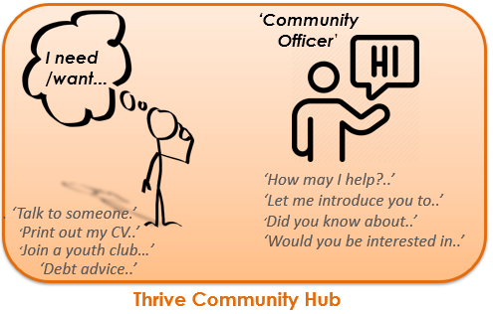
Thrive Community Hub Walk in → Talk to us → Connect in to your community
The Hub could be situated in an accessible location, offering a joined-up service to all ages in our community:
Acts as a ‘central Hub’, where people can drop in to find out about services either directly provided or virtually coordinated from multiple locations.
These services, we hope, will form complimentary ‘Micro-Hubs’ of different activities and topics.
Promotes early intervention and creative team building and networking opportunities to develop community knowledge and skill-set

Slide 12
Forming Micro-hubs
These are diverse established parts/groups of our community that can offer health promotion and life experience.
The Central Hub will connect the Micro-hubs to local people so they can be directed to the right type of intervention - very interactive and vocational;
Fun activities, social clubs and events;
Inviting locals to gain entrepreneurial skills by showing them different work environments within the micro-hubs, getting them involved with community affairs and allowing them to shape their own aims through this experience;
This joined up approach could allow for job vacancies to be made aware of and recommended quicker to the local.

Slide 13
External Community Facility
WHAT would you like to do? WHERE?

Slide 14
The System
Orange box = Thrive Community Hub
Purple Writing = Micro-Hub’s
Blue Box = External Facilities

Slide 15
Job Roles- Thrive Community Hub – would ideally support vulnerable groups and host the following paid/ funded job roles:
• Community Officer Hub/project Manager; First point of call/reference for community partnerships in relation to community need/ board meetings; overseer of other job roles under the thrive project; health and safety and regulation/policy; codes of conduct
• Youth and Community Worker Outreach worker; has very good relationship with the community and the youth; has full rains when it comes to creating/brainstorming with the community and youth about new incentives; driver for change; works with micro-hubs to create incentives that have the right safeguarding measures to accommodate for the vulnerable groups; can ask the community questions and do surveys so that we have a constant feedback loop.
• Learning Development Lead Runs Interactive rural community learning resource/helps plan community health promotion; upskilling; workshops; manages qualifications; working with nursery; primary schools; high schools; School leavers; College Students; Mature Students

Slide 16
• Social Prescribing Adviser Nonclinical social prescription/ Connecting low risk people into community; signposting; referrals into community service; time to talk
• Health Justice Worker Promoting rights in aid of health; benefits advice; empowering public health and advancing health equity; healthy neighbourhoods; homelessness
• Community Environmental and Ecological Officer Understands horticulture; soil science; mycology; plant science/ pollination cycles/ how that interacts on a larger scale with the local ecology; the symbiotic relationship of us and our environment that impacts on our human constructed life and can help the community be amerced into our primitive sense of being; forest gardens and forest schools; ‘Going Wild in BC’; foraging; bush craft; reconnecting back to the earths cycles/seasons and animal population. Helping connect all generations to environmental incentives that promote communal sharing and co-operative team work; works alongside the primary school/high school/thrive/community gardens/allotments/smallholding/farms and farm shops.
• Events/Festivals Planning Officer Making events; helping groups arrange events/festivals; marketing/ promotion of events; working with all job roles to create tailored incentives that the community wants; talking with events suites and facilities
• Volunteer Co-ordinator Organising volunteers; creating and updating a volunteer database; training and overseeing volunteers; induction packs and working with up-skilling all generations through volunteering.

Slide 17
Micro- Hubs already in the community
Some Community Projects Involving Volunteer Community Members:
Going Wild in BC is an initiative to make Bishop’s Castle visually greener and more attractive as well as increasing its bio-diversity;
Restore Shropshire Verges Project - continues on the crossroads (up to 1,000 wildflowers planted), and soon to start on the ‘Straight Mile’. Volunteers needed for cut-and-clear in July;
Community College Vegetable Garden - supplying fresh produce to the College kitchen. Help needed, 1-2 hours per week
Bishop's Castle Community Seed Bank - starting soon with a launch day in August at Little Woodbatch Market Garden, which will be the home of the Seed Bank;
Repair Shop - starting up in Enterprise House;
Dementia-Friendly Community - Bishop’s Castle has been recognised by the Alzheimer’s Society as a community working towards being Dementia Friendly;
Befriending Service - that provides companionship for isolated people, the chance to develop a new relationships and opportunities to participate in social activities;
Bishop’s Castle ‘Freegle’ site - started 2014, now with over 1,000 users offering free items for collection;
‘Fight the Plastics’ campaign – a first in Shropshire!

Slide 18
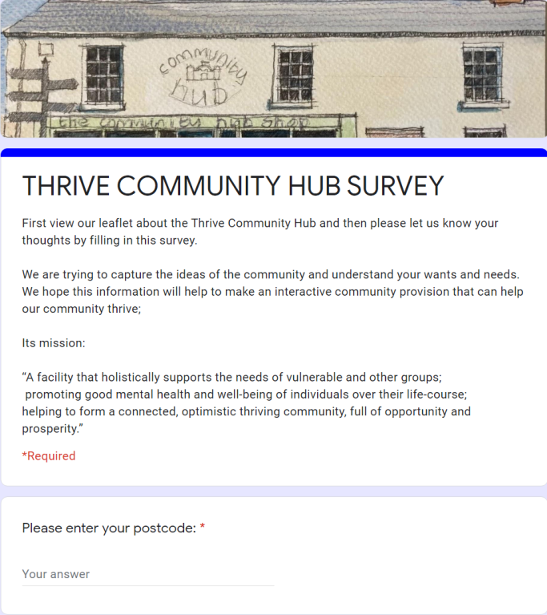
Involving the community
Community Engagement Strategy:
Inform - produce a definition and description of the sorts of services the Hub might provide and distribute to the community using paper-based and online media;
Consult - Survey the wider community for their views on the above services and to suggest what is missing, etc.;
Involve - Focus groups and visioning workshops to define the breadth of services required by community groups;
Collaborate - working with community groups to design the running of services;
Empower - establish steering groups to oversee the running and development of services.

Slide 19
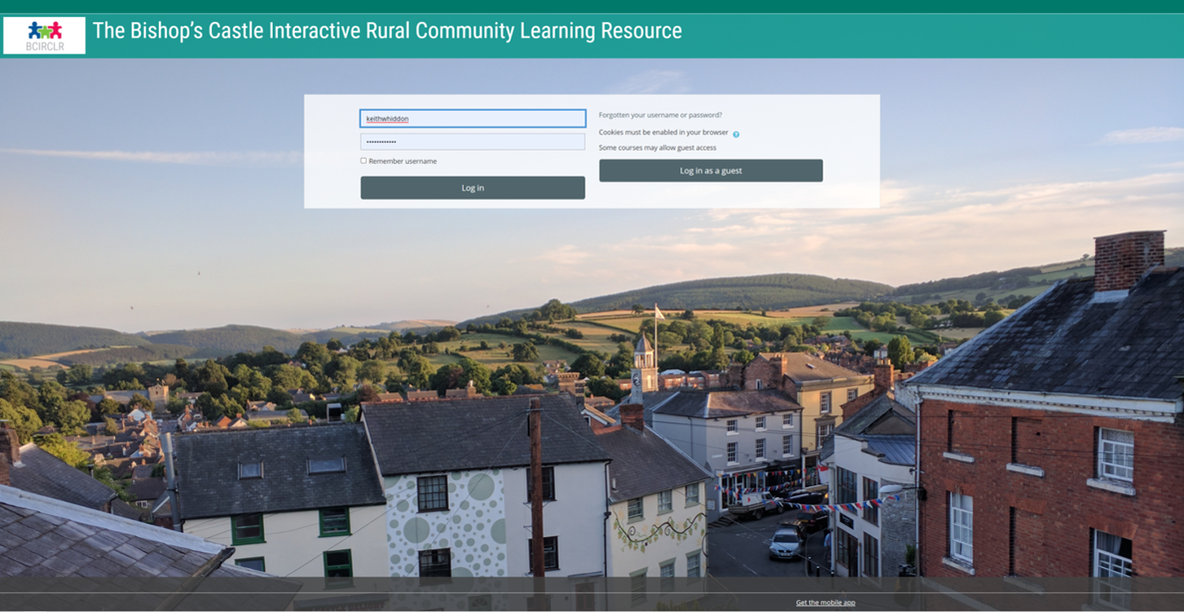
Bishop’s Castle – Interactive Rural Learning Resource ( Virtual Community Hub)
STILL SETTING UP THE WEBSITE - NOT LIVE YET
Go onto the website
Make an account
Gain access to a wide range of community resources.
https://bishopscastlecommunity.org.uk/moodle/
a resource interactive learning;
information and resources base around support and to raise awareness of Mental Health;
promote opportunities for individuals to join community projects;
a place to showcase community knowledge;
a place for people to share their memories;
provide opportunities for individuals to undertake online courses

Slide 20
Working in Partnership
A bid has been won so that our community can set up an online resource. The creation of the Moodle site has been made possible through a grant from the Cameron Grant Memorial Trust.
Cameron Grant took his own life in November 2014 aged just 21. He suffered from depression for seven years before he died, but managed to hide this from everyone who knew him.
AIM: The preservation and protection of good mental health in particular in young people
.

Slide 21
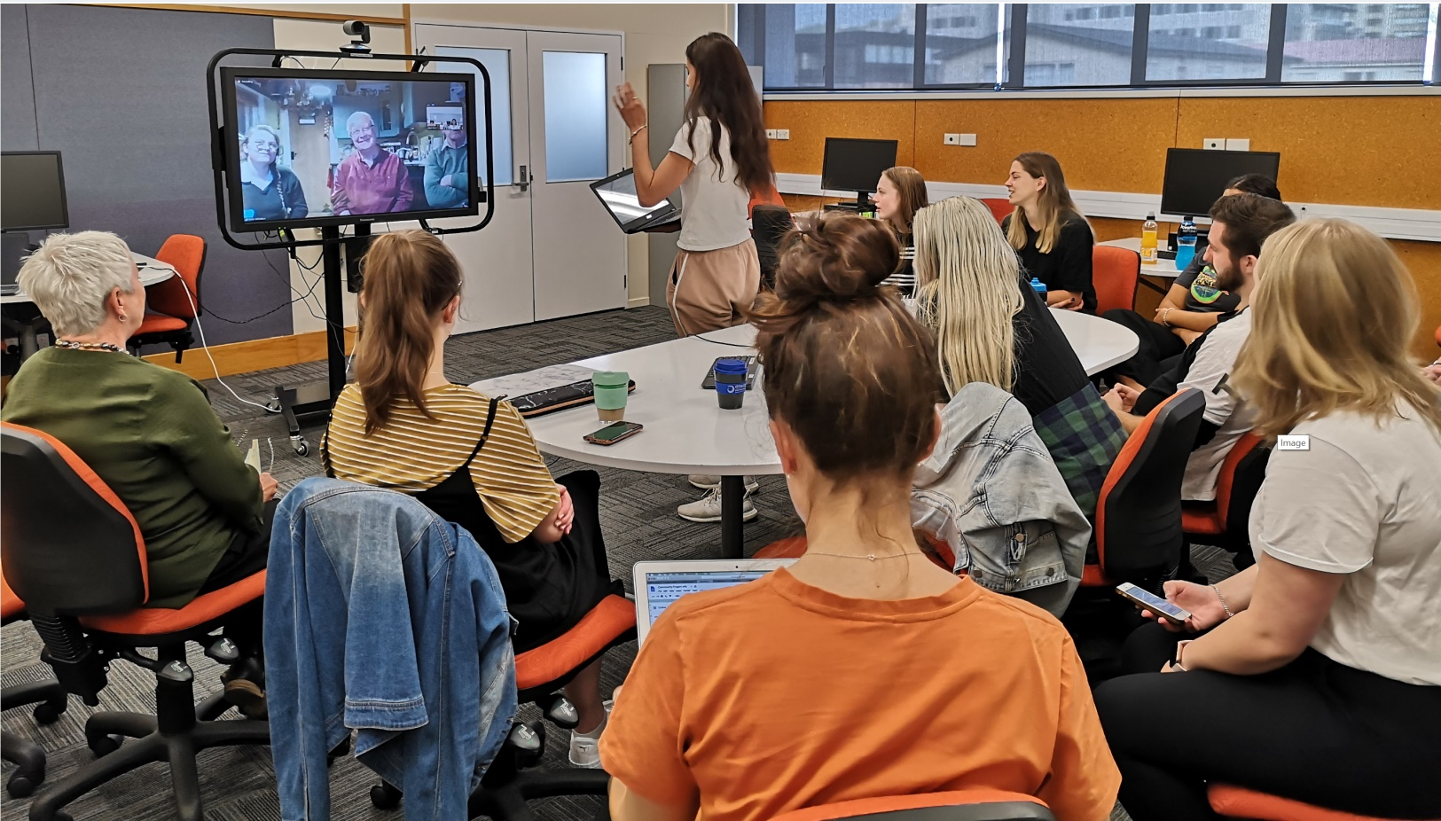
Working in Partnership
As part of their nursing degree, 12 student nurses in New Zealand studied Bishop’s Castle (remotely!) for a whole month.
They were provided with background information about the Town and asked us numerous questions to help them identify some of our main community health and well-being needs.
Mental Health
Bishop’s Castle has limited mental health resources - 9 suicides
within the last 5 years
Physical Health
Food poverty is an issue for Bishop’s Castle and impacts on health
Smoking, drug and alcohol misuse are issues

Slide 22
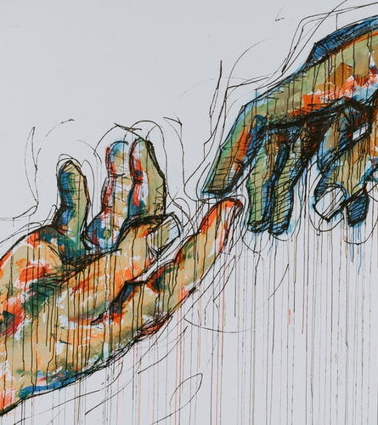
Who will it benefit
Individual Community Member’s >Low income/ Children in Poverty >Isolation/ loneliness >Accessibility for youth
Community Groups
Partnerships >Police >Schools >GP’s >charities and Trusts
Statutory Organizations >Social Prescribing

Slide 23
How to get involved
To have a say, help and volunteer; Join the Bishop’s Castle Community Partnership Look at our leaflet and complete our survey so that your opinion is accounted for & encourage others to fill it in. Look out for regular updates on our Facebook Page and Our Website
Find our Survey Online at; http://bishopscastlethrive.org.uk/survey https://www.facebook.com/BCThrive Join our Interactive Rural Learning Resource when it is live → https://bishopscastlecommunity.org.uk/moodle/
If you have any questions Email us: Info@bishopscastlethrive.org.uk

