Slide 1
The Bishop’s Castle Community Partnership (BCCP)
The BCCP is an independent charity with the aim to advance citizenship and community development. It brings together individuals and groups with a shared interest in Bishop’s Castle under a common action plan, planned and delivered as one.
The BCCP is responsible for delivering the Community-Led Town Plan for the benefit of our local community. It is a community-owned plan that highlights actions to be taken by the community in partnership with the Town Council and other local organisations.
The Plan brings together existing organisations and local volunteers to run projects and form working groups to tackle specific issues. It is not about replicating the work already being done, but is a way of coordinating this work so that opportunities may be identified and issues shared for mutual benefit.
It is by working together as a community that we will make Bishop’s Castle an even better place in which to live and work.
07971 661615
townplan@bishopscastle.gov.uk
www.facebook.com/communityplan/
www.bishopscastletowncouncil.gov.uk/town-plan/

Slide 3
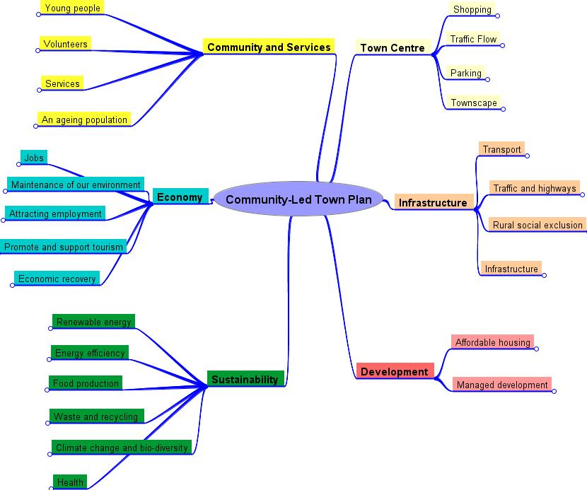
The Community-Led Town Plan
Community-Led Town Plan was launched in October 2016 and the actions are updated annually.
It has 6 themes designed to address the issues identified by the Bishop’s Castle community:
Town Centre;
Community and Services;
Economy;
Sustainability;
Infrastructure and
Development
The Community Partnership is working in partnership with the Town Council in their development of a Neighbourhood Plan for Bishop’s Castle.
The Neighbourhood Plan is concerned with planning decisions, whereas the Community-Led Plan covers all things important to a community.
Both plans work together for the future benefit of the Town.

Slide 4
Sustainability Projects
Climate and Bio-Diversity Action Plan (adopted by Town Council) https://bishopscastletowncouncil.gov.uk/sustainability/
Local Food Resilience Strategy Plan (adopted by Town Council) https://bishopscastletowncouncil.gov.uk/sustainability/
Restore Shropshire Verges Project continues on the crossroads (up to 1,000 wildflowers planted). Volunteers needed for cut-and-clear in July. E-mail townplan@bishopscastle.co.uk
Community College Vegetable Garden, supplying fresh produce to the College’s kitchen. Help needed, 1-2 hours per week E-mail townplan@bishopscastle.co.uk
‘Fight the Plastic’ campaign – a first in Shropshire!
Bishop’s Castle ‘Freegle’ site: started 2014, now with over 1,000 users offering free items for collection
Neighbourhood Plan: Climate Mitigation ideas paper submitted for inclusion, including high energy standards for new builds https://bishopscastletowncouncil.gov.uk/sustainability/
Energy Diary - created for use in local schools https://lightfootenterprises.org/

Slide 5
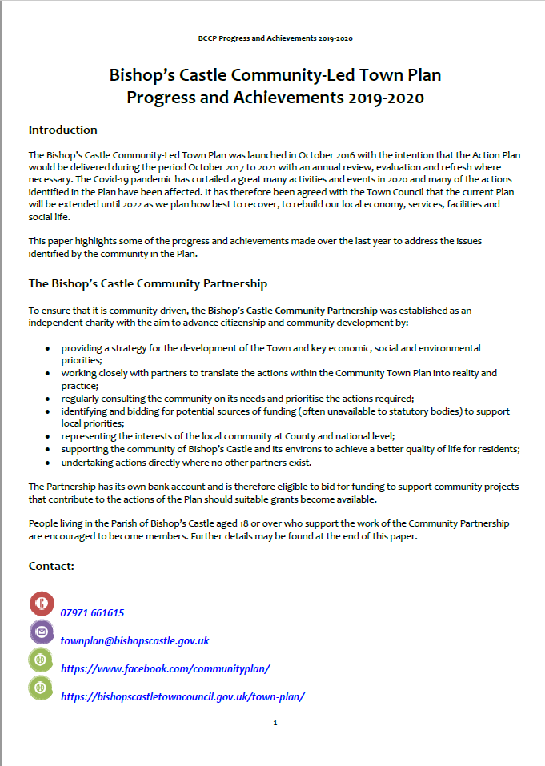
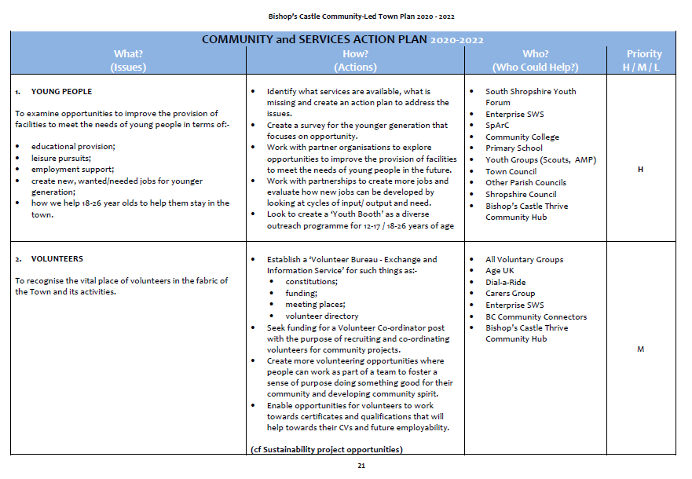
Progress and Achievements 2019-20 / Community Town Plan 2020-22

Slide 6
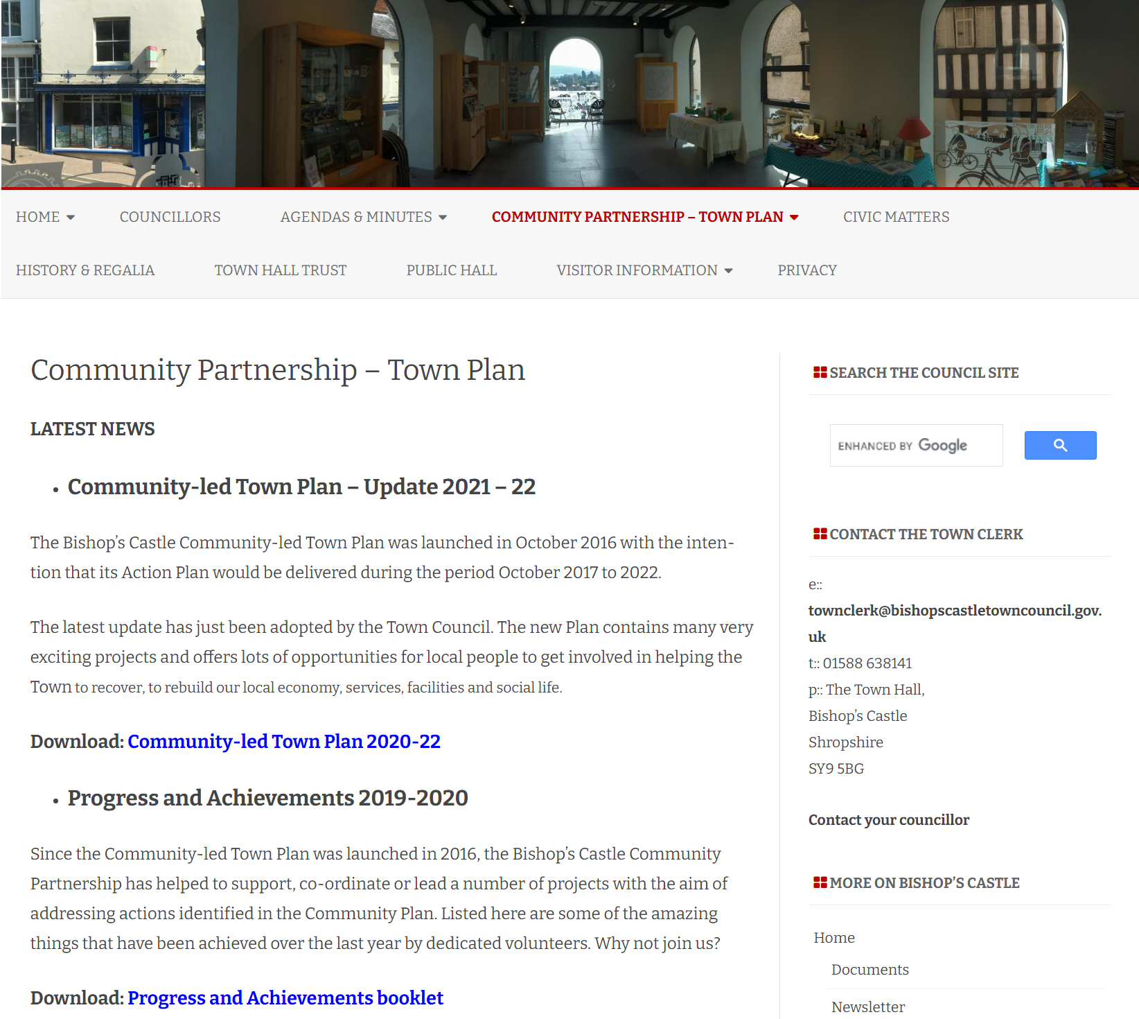
www.bishopscastletowncouncil.gov.uk/town-plan/

