Slide 1


Shaping Places for Healthier Lives: Solving Food Insecurity in South-West Shropshire
https://shropshire.gov.uk/healthy-shropshire/shaping-places-for-healthier-lives/
emily.fay@shropshire.gov.uk

Slide 2
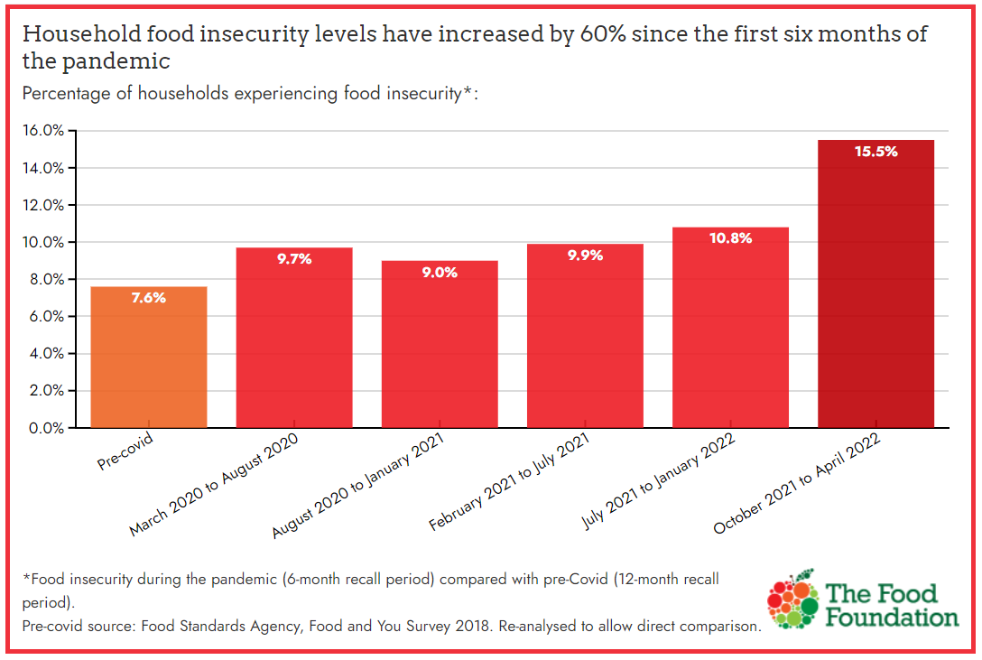
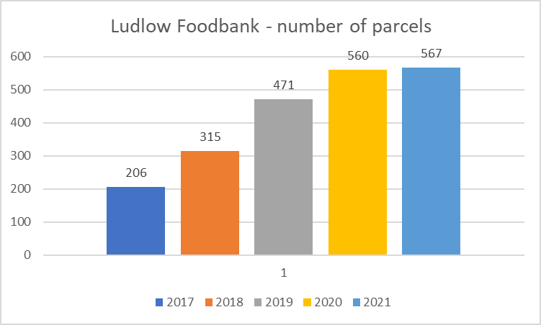
Food insecurity is growing nationally, including here in Shropshire.
NATIONAL
LOCAL
Food Insecurity has increased by 57% since January
More than 2 million households went without food in April
13.8% of households (7.3 million adults) experienced food insecurity in April
1 in 5 households with children have experienced food insecurity in the past 6 months
2021
13.87% in food insecurity
5.36% Shropshire residents experience hunger
9.31% households worried about their food insecurity LGA
Last year Ludlow Foodbank supported 803 different people

Slide 3












Project Timeline
Outcomes
More people coming
forwards for support
Reduced levels of financial
issues (debt, eviction)
Improved access to
healthy, affordable food
Improved diets =
less diet-related ill health
Improved health
and wellbeing
Reduced health
inequalities
Reframe
Reduce stigma
More people getting support
Discovery
Phase
Strengthen
the System
Maximise Incomes
Improve navigation
Real living wage
Underclaimed financial support
Wide Lens:
Understand the landscape
Close-up Lens:
Understand experiences
Bring partners together
Understand complexity
Co-design pilot solutions
Community
Local projects
Increase access: food and skills
WE ARE HERE
2021
2022
2024

Slide 4
Cost of Living Crisis
Energy prices rose 54% in April and are predicted to rise again in October – no price cap for oil/LPG
Inflation is predicted to rise to 8.7% by the end of 2022, the highest in 40 years. Expected to lead to a 2.2% in household disposable income, the biggest fall in living standards since records began in 1956 (OBR)
In April almost 90% of households reported an increase in their cost of living. A quarter struggled to pay their bills and 17% turned to loans or borrowing to make ends meet (ONS)
An estimated 34.2 per cent of the population are now living below the Minimum Income Standard. The average financial shortfall will be £8,600. Families with children will be particularly impacted. (NEF)

Slide 5





Joint Communications
We know that many people across Shropshire will be worrying about the increases in the cost of living. We want everyone to know that:
They are not alone
There is help available
They shouldn’t wait to ask for help

Slide 6
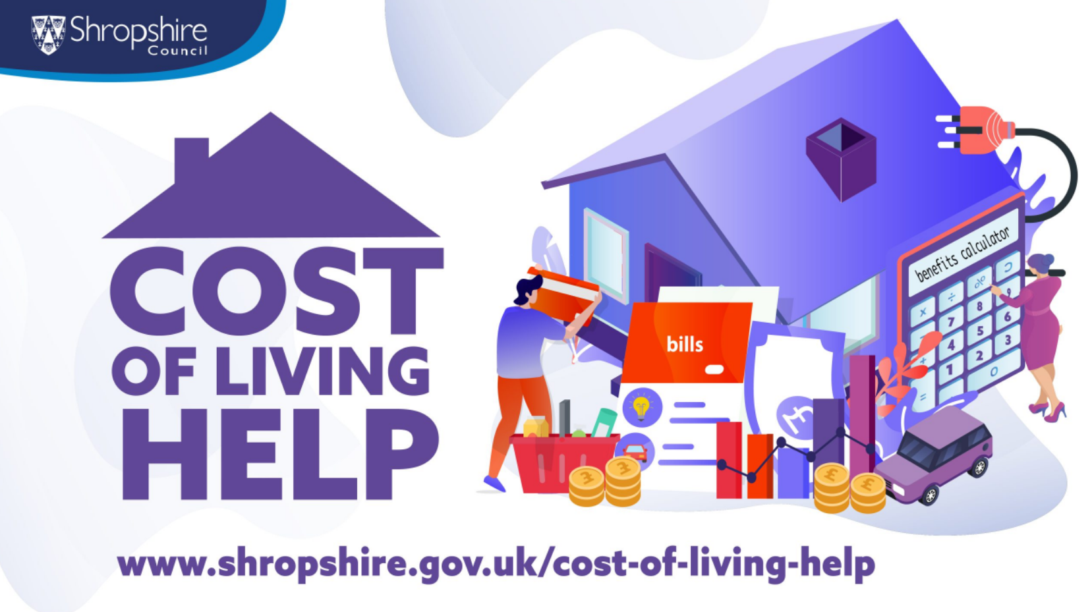

Slide 7
Other helpful resources
https://www.shropshirelarder.org.uk/ - Is a community resource for people in Shropshire living on low incomes
https://www.worryingaboutmoney.co.uk/shropshire - Worrying about money leaflet
https://www.entitledto.co.uk/ - Check if you are missing out on any financial support
https://www.cabshropshire.org.uk/
https://mea.org.uk/ - Worried about energy bills? Marches Energy Agency are a local charity who can help
https://www.community-resource.org.uk/
https://www.moneysavingexpert.com/family/cost-of-living-survival-kit/

